Slide 1
Visual assets for host’s communication plans
Please feel free to use these visual assets as you best see fit.
We encourage you to adopt your own organizational branding.
Please only use the logos provided in this pack for this workshop.

Slide 2







Getting started with sustainability
An introduction for SMEs and beginners
ORGNIZED IN PARTNERSHIP WITH
Notes:
Hello everyone, and welcome.
We’ll be starting shortly with this interactive workshop on sustainability for SMEs.
Today is designed to be practical and relevant — whether you’re new to this topic or already exploring it.
The goal is simple: by the end, you should feel confident about why sustainability matters for your business — and what your first steps could look like.
Before we dive in, I want to thank our partners for helping make this workshop possible - particularly the IFC and the Government of Switzerland for providing financial support for this project. Also a thank you to the Ethical Supply Chain Program for joining us today to provide practical insight from their experience working with SMEs on this topic.

Slide 3

Understand the relevance of sustainability-related information
GOALS
Integrate sustainability into your strategy and governance
Identify key sustainable business practices to get started
Map out key audiences that may require sustainability information
Notes:
By the end of today, you should:
Understand why sustainability information matters
See how it connects to your strategy
Identify practical first steps
And understand who you may need to communicate with
Most importantly — this is not about perfection.
It’s about understanding enough to start and build over time.

Slide 4
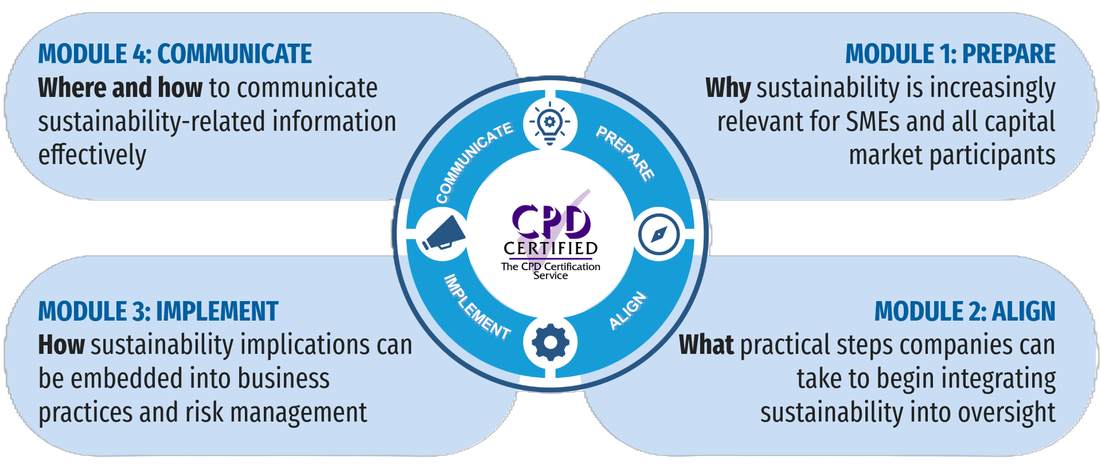
Four facets of sustainability integration
Notes:
To achieve these goals, This workshop follows four key steps:
Prepare, Align, Implement, and Communicate.
Think of this as a practical roadmap — not something you do once, but something you revisit as your business evolves.

Slide 5
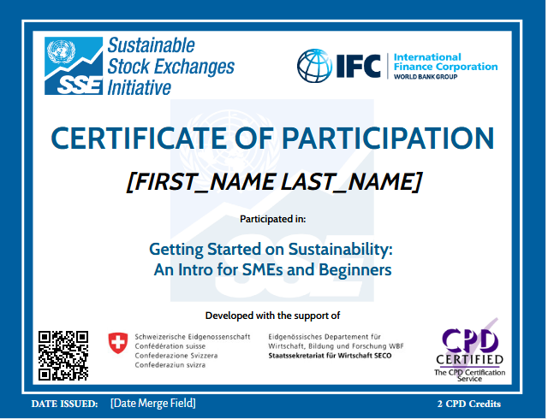
Join us to receive your personalized certificate worth 2 CPD credits

Slide 6
Facilitated by
In partnership with
Logos for Host to use for this workshop’s invitations
Supported by
This training program was developed with the support of the Swiss State Secretariat for Economic Affairs (SECO)

Slide 7
Exchange Logo
FREE ONLINE WORKSHOP
Getting Started on
Sustainability
An intro for SMEs & beginners
01 Prepare
02 Align
03 Implement
04 Communicate
⏱
120 minutes
Live facilitation
💻
Online · Interactive
Q&A open throughout
📅
[Date & Time]
Register now
In Partnership with
Facilitated by UN SSE · CPD Certified · sseinitiative.org/academy

Slide 8
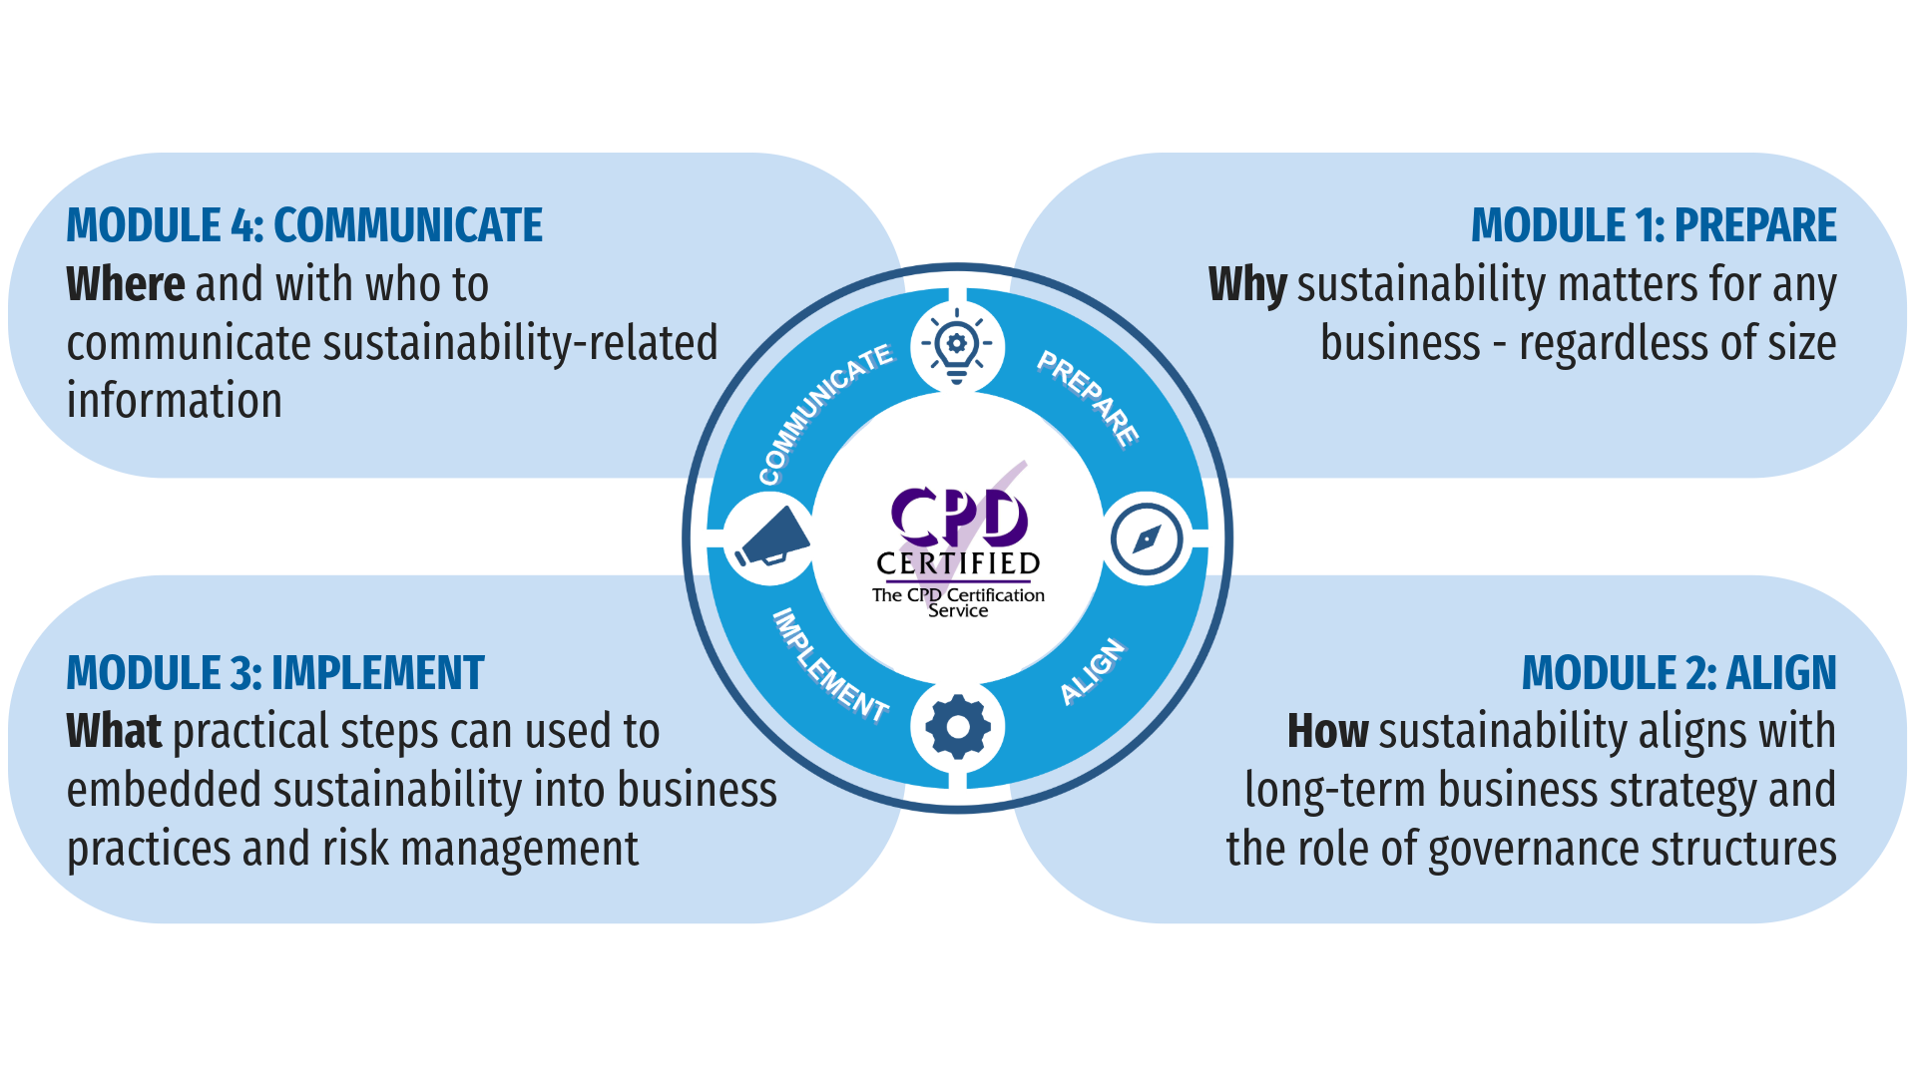
Exchange Logo
FREE ONLINE WORKSHOP
Getting Started on
Sustainability
An intro for SMEs & beginners
In Partnership with
Facilitated by UN SSE · CPD Certified · sseinitiative.org/academy

