Slide 1
Visual assets for host’s communication plans
Please feel free to use these visual assets as you best see fit.
We encourage you to adopt your own organizational branding.
Please only use the logos provided in this pack for this workshop.

Slide 2







JOIN US FOR THIS UPCOMING LIVE VIRTUAL WORKSHOP
BOARD OVERSIGHT OF ISSB-ALIGNED REPORTING
In partnership with
Notes:
Hello everyone, and welcome.
We’ll be starting shortly with this interactive workshop on Board Oversight of ISSB-Aligned Reporting
Today is designed to be practical and relevant — whether you’re new to this topic or already exploring it.
The goal is simple: by the end, you should feel confident about what you need to do to prepare yourself to oversee sustainability disclosure that use the ISSB Standards
Before we dive in, I want to thank our partners for helping make this workshop possible - particularly the IFC and the World Bank’s SDG Partnership Fund for providing financial support for this project.

Slide 3

Understand the role of boards in overseeing ISSB-aligned reporting
GOALS
Update guidelines for risk management practices
Build sustainable governance structures
Challenge sustainability data
Notes:
So what are we here to achieve today? By the end of this session, we want you to leave with four things.
First, a clear understanding of the role of the board in overseeing ISSB-aligned reporting — what that oversight looks like in practice.
Second, we want to help you update the way you think about risk management practices in light of sustainability-related requirements.
Third, we want to help you think about how to build governance structures that are fit for purpose in this new landscape.
And fourth — and this one is perhaps the most immediately practical — we want to help you feel equipped to challenge sustainability data when it's presented to you. Boards don't need to be technical experts. But they do need to ask the right questions.

Slide 4
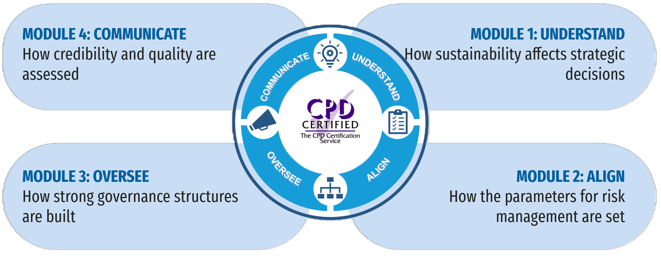
Four facets of sustainability integration
Notes:
To achieve these goals, This workshop follows four key steps:
Prepare, Align, Implement, and Communicate.
Think of this as a practical roadmap — not something you do once, but something you revisit as your business evolves.

Slide 5
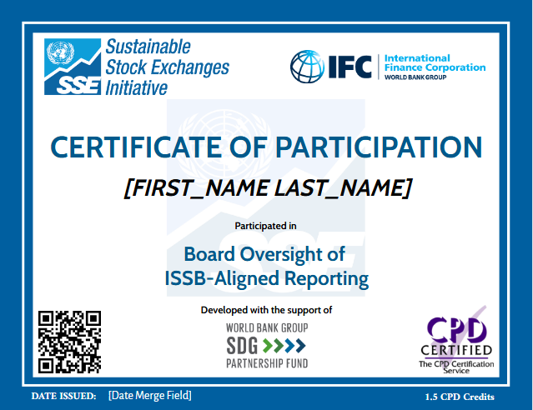
Join us to receive your personalized certificate worth 2 CPD credits

Slide 6


Facilitated by
In partnership with
Logos for Host to use for this workshop’s invitations
This program was developed with support from the
World Bank Group SDG Partnership Fund

Slide 7



Exchange Logo
FREE ONLINE WORKSHOP
Board Oversight of
ISSB-Aligned Reporting
01 Understand
02 Align
03 Oversee
04 Communicate
⏱
90 minutes (+15 min optional Q&A)
Live facilitation with global experts
💻
Online · Interactive
Q&A open throughout
📅
[Date & Time]
Register now
In Partnership with
Facilitated by UN SSE · CPD Certified · sseinitiative.org/academy

Slide 8
Exchange Logo
FREE ONLINE WORKSHOP
Board Oversight of
ISSB-Aligned Reporting
In Partnership with
Facilitated by UN SSE · CPD Certified · sseinitiative.org/academy

