Slide 1
COMMUNICATIONS SUPPORT PACKAGE AND BRANDING GUIDE
FOR TRAINING WORKSHOP ON THE IFRS SUSTAINABILITY DISCLOSURE STANDARDS S1 AND S2

Slide 2
Communications Support - Overview
This communications pack has a series of communications ideas and images that your communications team is welcome to use when sharing the opportunity to participate in this workshop to your market. The package also has draft text you may wish to use when emailing your market about this opportunity.
These materials are available to be used however you see fit when communicating with your market.
Please remember – these workshops are designed to have a large number or participants, so the objective is to extend this invitation and offer to achieve a CPD certificate on this topic to as wide of an audience as possible.

Slide 3
Practical Information on the workshop
Practical Information on IFRS Sustainability Standards Training
The Standards:
IFRS S1 – General Requirements for Sustainability-Related Financial Information
IFRS S2 – Climate-Related Disclosures
Goals of the workshop:
To build participants’ understanding of the foundations of the IFRS Sustainability Disclosure Standards
To help capital market participants to implement the standards
To build capacity for consistent, global uptake of the standards.
Content of the workshop:
Step-by-step practical guidance to help participants build the foundations needed to:
Prepare for the standards and understand the changing disclosure landscape
Align to global and local standards for identifying financially material risks and opportunities
Implement governance, strategy, risk management and measurement processes that meet the standards
Communicate efficiently and effectively the company’s resilience to climate- and sustainability-related factors
Format of the workshop:
Delivered in one morning or afternoon over 3.5 hours with a short break halfway through
Facilitated and organized by the UN SSE, IFRS Foundation and IFC via Zoom (virtual)
Hosted by the stock exchange (with welcome remarks provided by the stock exchange)
Designed to facilitate up to 1,000 participants, with interactivity managed through zoom polls, mentimeter activities and Q&A and chat
Minimum participation of 100 people required

Slide 4
WHEN to communicate this opportunity
When?
We recommend beginning your communications campaign at a minimum 3 weeks in advance. If you want support crafting your communication campaign, please feel free to reach out. It's also advisable to encourage your regulator and other local partners to help share the invitation. We will help you spread the word by sharing an invitation for dissemination via the IFC and UN Global Compact local networks, but we require the exchange to start advertising before we do this.

Slide 5
HOW to communicate this opportunity
How?
You may wish to communicate this opportunity with market participants by email, through social media, and/or other means such as direct calls or via partners. The objective is to reach as many market participants as possible (up to 1,000 can join the webinar) to have the greatest impact. The more individuals that understand the standards and how they can be used, the more resilient the market becomes.

Slide 6
WHO to communicate this opportunity to
Who?
This training is designed for a large number of participants, from all parts of the organization. Sustainability-related financial disclosures require all employees to have a basic understanding of this topic – for example, it requires collaboration from various departments including those working on finance, strategy, communications, audit, research & development, human resources, natural resources, accounting, risk management, sustainability, etc. In addition, all board members should have a substantial foundational knowledge of these standards to be able to review the company’s resilience. It is often useful to have one broad communications campaign to reach all market participants, as well as a few targeted campaigns aimed to ensuring select market participants (such as board members, sustainability officers and report preparers) are aware of this opportunity.

Slide 7
Sample e-mail announcing the workshop
SUBJECT: Invitation to free 1/2-day, CPD-Certified workshop on the ISSB’s Standards
Dear Market Participants,
We are very pleased to offer all the board members and employees of your organization an opportunity to participate in a CPD-Certified training workshop on the latest sustainability disclosure standards by the International Financial Reporting Standards (IFRS). We are pleased to offer you this opportunity to ask questions and interact with the top experts on this topic. This live and interactive workshop is facilitated by top experts on this subject, from the IFRS Foundation, UN SSE and the World Bank’s IFC. We will be hosting this training workshop free of charge for all market participants, and we encourage you and your colleagues to participate in this workshop to build a solid understanding of the IFRS Sustainability Disclosure Standards, organization-wide.
In June 2023, the International Financial Reporting Standards Foundation (IFRS) ushered in a new era of corporate sustainability-related disclosure to capital markets worldwide with the launch of IFRS S1, “General Requirements for Sustainability-related Financial Information” and IFRS S2 “Climate-related Disclosures.” The IFRS Sustainability Standards were developed by the International Sustainability Standards Board (“ISSB”). These standards provide a global baseline for sustainability disclosures, providing companies with clear guidelines for globally consistent disclosure of sustainability-related financial information. Find out more about the modules of this training program here [insert your exchange’s unique webpage link here].
We encourage you to share this opportunity throughout your organization. All levels and roles can benefit from this capacity building opportunity. Sustainability-related financial disclosures require all employees to have a basic understanding of this topic. For example, it requires collaboration from various departments including those working on finance, strategy, communications, audit, research & development, human resources, natural resources, accounting, risk management, sustainability, etc. In addition, all board members should have a substantial foundational knowledge of these standards to be able to review the company’s resilience.
The workshop provides a high-level overview of the standards as well as technical guidance on getting started and enhancing disclosure practices to meet the requirements of the standards. By joining this live and interactive workshop, participants can ask the experts the questions they need answered to improve their sustainability disclosures. Upon completion of the workshop, participants that fill in a feedback survey will receive a CPD certification for 3.5 CPD credits. Please register below:
📅 Date: [Insert date here]
⏰ Time: [Insert time here]
💻 Place: Online → Register here: [Insert zoom registration link here]

Slide 8
Before the workshop Social media sample post
Did you catch the release of IFRS S1 and S2 on Sustainable and Climate Disclosure? Wondering how these standards are reshaping sustainability-related disclosures globally?
We are teaming up with experts from the IFRS Foundation, United Nations Sustainable Stock Exchanges initiative and the World Bank’s IFC for a free, CPD-Certified online workshop, “Applying the IFRS Sustainability Disclosure Standards”.
This capacity building workshop provides a half-day of learning at no cost. It aims to support our market participants in effectively implementing ISSB S1 and ISSB S2, promoting a consistent and widespread global adoption of sustainability disclosure standards. Don’t miss out on your CPD certification for participating.
Share the invite among your network to ensure everyone in our market is prepared for the sustainability-related risks and opportunities ahead!
📅 Date: INSERT DATE
⏰ Time: INSERT TIME
💻 Place: Online → INSERT REGISTRATION LINK
Register now to save your virtual seat!
#sustainability #ISSB #IFRS #IFRSsustainability #exchanges #disclosure #standards #greenfinance #sustainablemarkets

Slide 9
Before the workshop Social media sample post
Is your company equipped for the growing demand for decision-useful sustainability disclosures?
We are very excited to be hosting a free, CPD Certified virtual workshop on IFRS Sustainability Disclosure Standards, ISSB S1 (general disclosures) and ISSB S2 (climate-related disclosures). The workshop will be facilitated by the experts from IFRS Foundation, United Nations Sustainable Stock Exchanges Initiative and the World Bank’s IFC.
After this training, you will be equipped to identify sustainability-related issues, integrate them into decision-making process and measure progress & resilience. You’ll also receive a CPD certificate for 3.5 CPD credits upon completion!
Make sure to share the invite, as this workshop will have information for all levels and departments.
What? (Exchange’s Name) Training on IFRS Sustainability Disclosure Standards
When? Date
What Time? Time & time zone
Where? Online → Click the link to sign up: Registration link
Do not miss the chance to learn from experts, and to get all your questions answered! Register now!
#ESG #CSR #Transparency #Resilience #ISSB #IFRS #IFRSsustainability #capitalmarkets #sustainablemarkets #learning #upskill #workshop

Slide 10
Before the workshop Social media sample post
🌍 Wondering how disclosure standards will reshape stock markets globally? 📈
❓ Do you have questions about the new IFRS Sustainability Disclosure Standards you need answered? 🌱
📅 Register now to join our CPD-certified workshop for free! ✅
🎓 We’ve invited experts from the IFRS Foundation, the United Nations SSE initiative, and the World Bank’s IFC to help upskill our market on this topic. 💼
🔄 Share the invite with all your colleagues and colleagues in organizations you depend on most so that together we can enhance our organizational resilience! 💪
📅 Date: [Insert date here]
⏰ Time: [Insert time here]
💻 Place: Online → Register here: [Insert zoom registration link here]
#sustainability #ISSB #IFRS #IFRSsustainability #exchanges #disclosure #standards #greenfinance #sustainablemarkets

Slide 11
After the workshop Social media sample post
🌊 The IFRS Foundation made waves 🌿 with the release of its sustainability and climate disclosure standards S1 and S2, setting the stage for more effective, efficient, and globally-consistent disclosure of sustainability-related risks and opportunities facing listed companies. 🌐📊
🚀 To help our market enhance their skills to be able to effectively and efficiently make use of these standards, we invited experts from the IFRS Foundation, United Nations SSE initiative, and the World Bank’s IFC to help upskill our market on this topic. 💡📚
🙋‍♂️ Participants had the opportunity to ask the experts any questions, and to build new skills that will make the companies in our market more resilient! 🛡️🌱
Did you miss the workshop? You can watch the recording here: [insert link to SSE webpage for your event]
#ESG #CSR #Transparency #Resilience #ISSB #IFRS #IFRSsustainability #capitalmarkets #sustainablemarkets #learning #upskill #workshop

Slide 12
After the workshop Social media sample post
🌿📈 Transforming Markets: The IFRS has paved the way for more transparent and sustainable markets with the introduction of the ISSB S1 and ISSB S2 standards. These standards are revolutionizing how we disclose sustainability-related and climate-related risks and opportunities.
🛠️📚 Empowerment through Education: To empower our market participants with the necessary skills and knowledge for effective preparation, alignment, implementation, and communication of these disclosures, we organized a free, CPD-certified half-day workshop. This event featured insights from the IFRS Foundation, the United Nations SSE initiative, and the World Bank's IFC.
💼🌱 Interactive Learning Experience: The workshop offered an interactive learning environment with real-time Q&A sessions. Participants gained insights into the evolving disclosure landscape, understanding what needs to be disclosed to meet global standards and satisfy investor demand. Furthermore, they acquired strategies on utilizing ISSB standards for more effective and efficient communication, alongside developing robust strategies for sustainability-related financial disclosures.
If you have missed this enlightening workshop, here’s the link to the recording: [INSERT LINK TO SSE WEBPAGE FOR YOUR EVENT]
[ADD A QUOTE FROM YOUR EXCHANGE, OR ACKNOWLEDGEMENTS]
#sustainability #ISSB #IFRS #IFRSsustainability #exchanges #disclosure #standards #greenfinance #sustainablemarkets

Slide 13
Sample images you can use/adapt for your social media posts

Slide 14
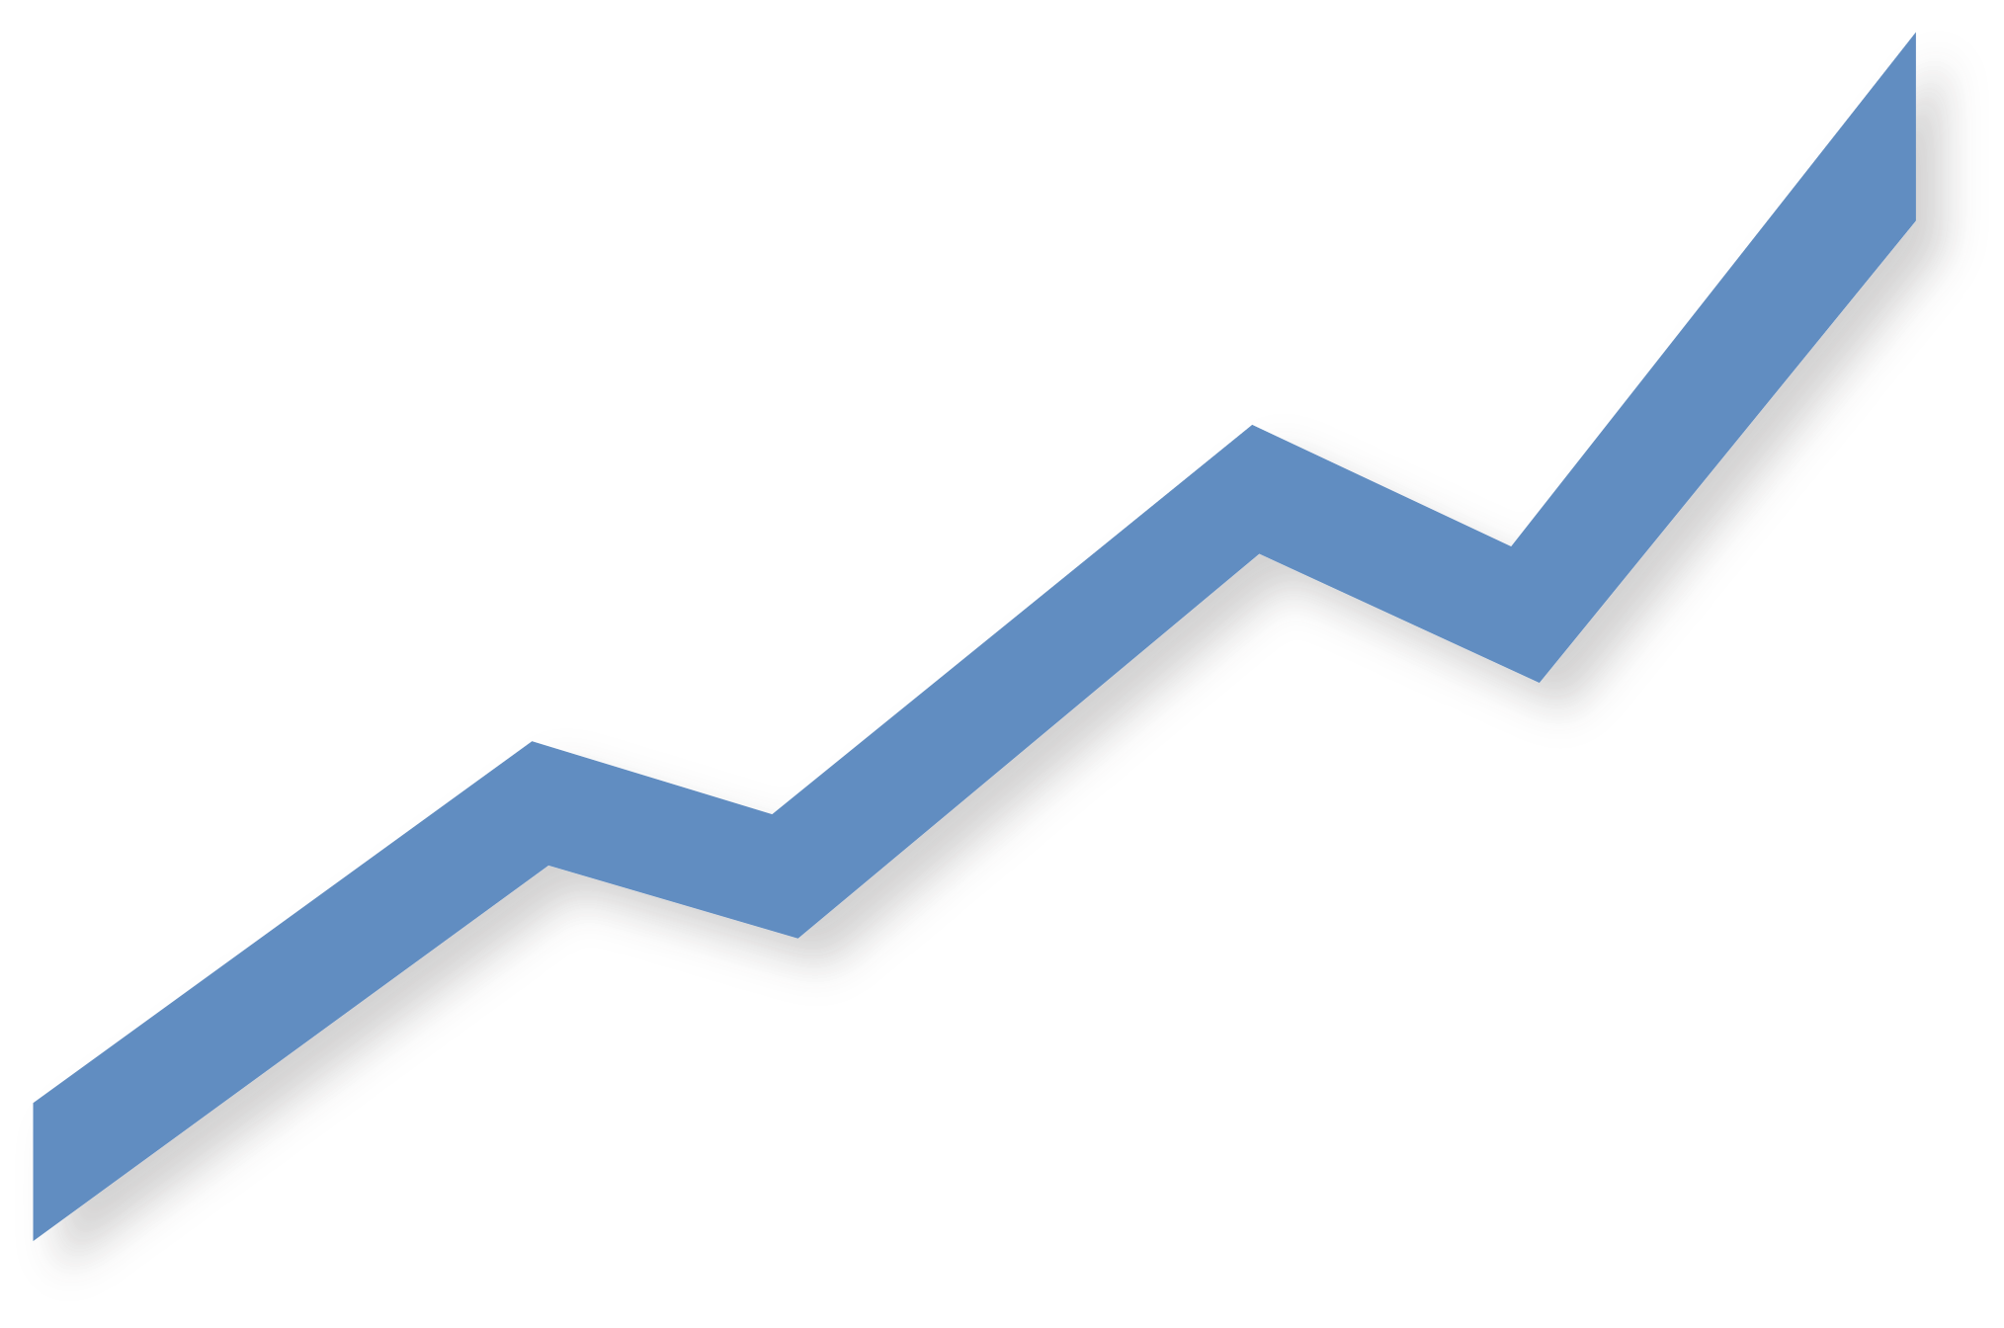
Your logo here
IFRS SUSTAINABILITY DISCLOSURE STANDARDS S1 & S2
INTERACTIVE WORKSHOP

Slide 15
Your logo here
IFRS Sustainability Disclosure Standards
Opening remarks by
NAME, ROLE,
EXCHANGE NAME
Your exchange representative here

Slide 16
Your logo here
IFRS Sustainability Disclosure Standards
“QUOTE FROM YOUR EXCHANGE LEADERSHIP ABOUT THE IMPORTANCE OF EDUCATING MARKETS ON NEW TOPICS SUCH AS THIS”
-CEO/Board Chair/Director, Name of Exchange

Slide 17
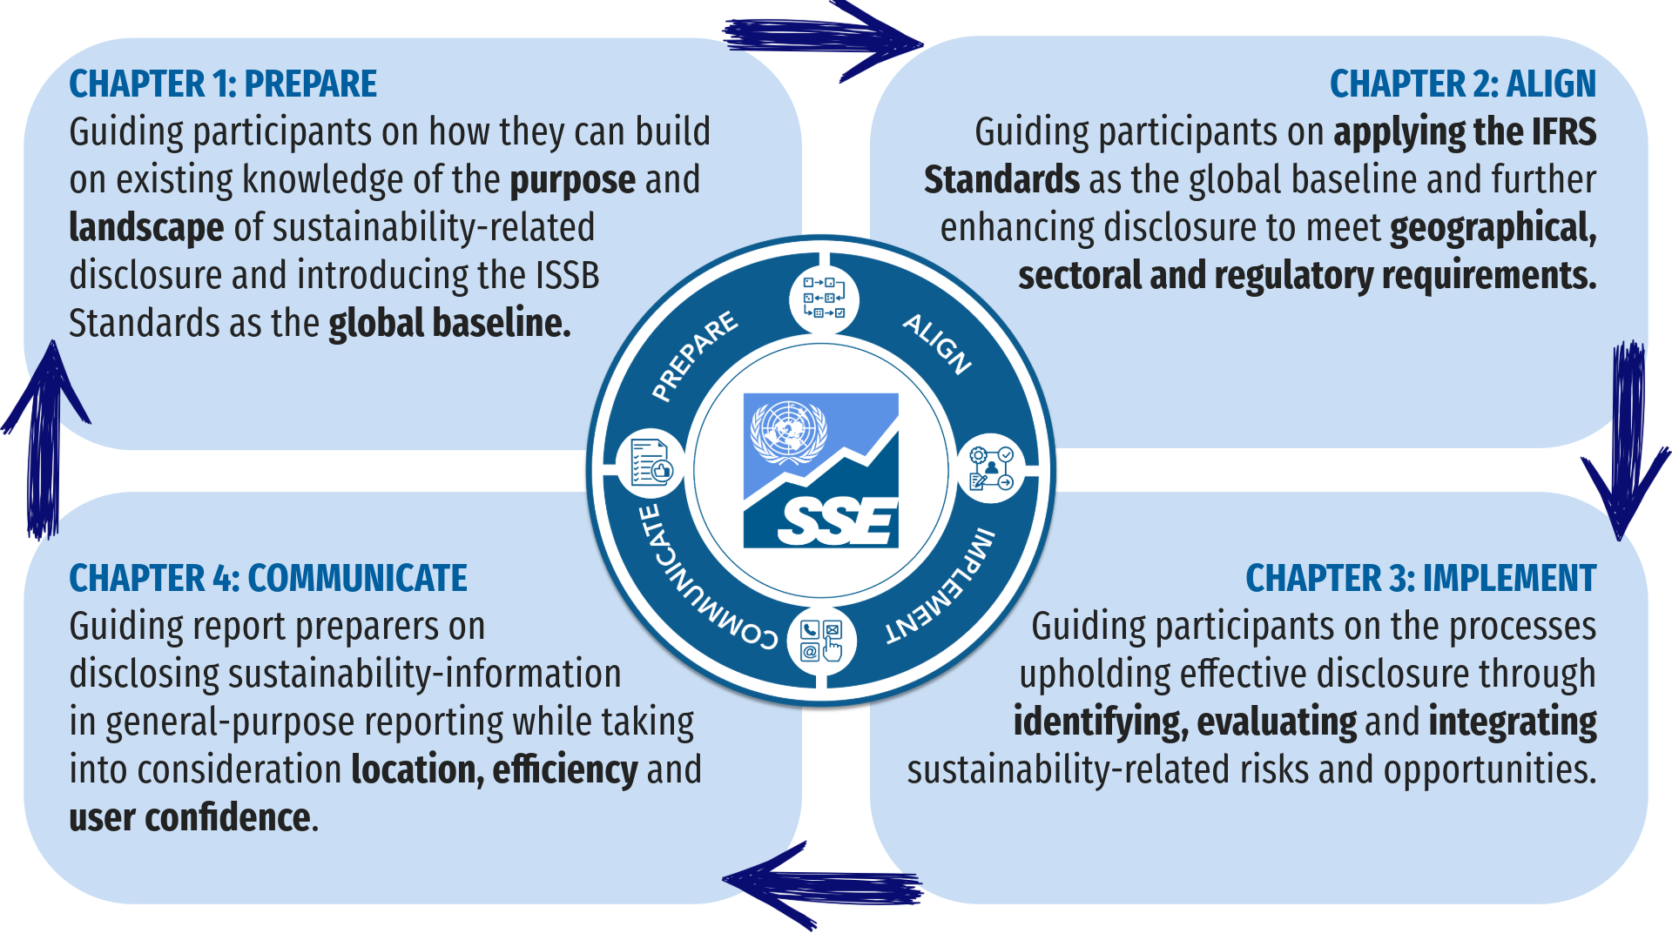

Slide 18
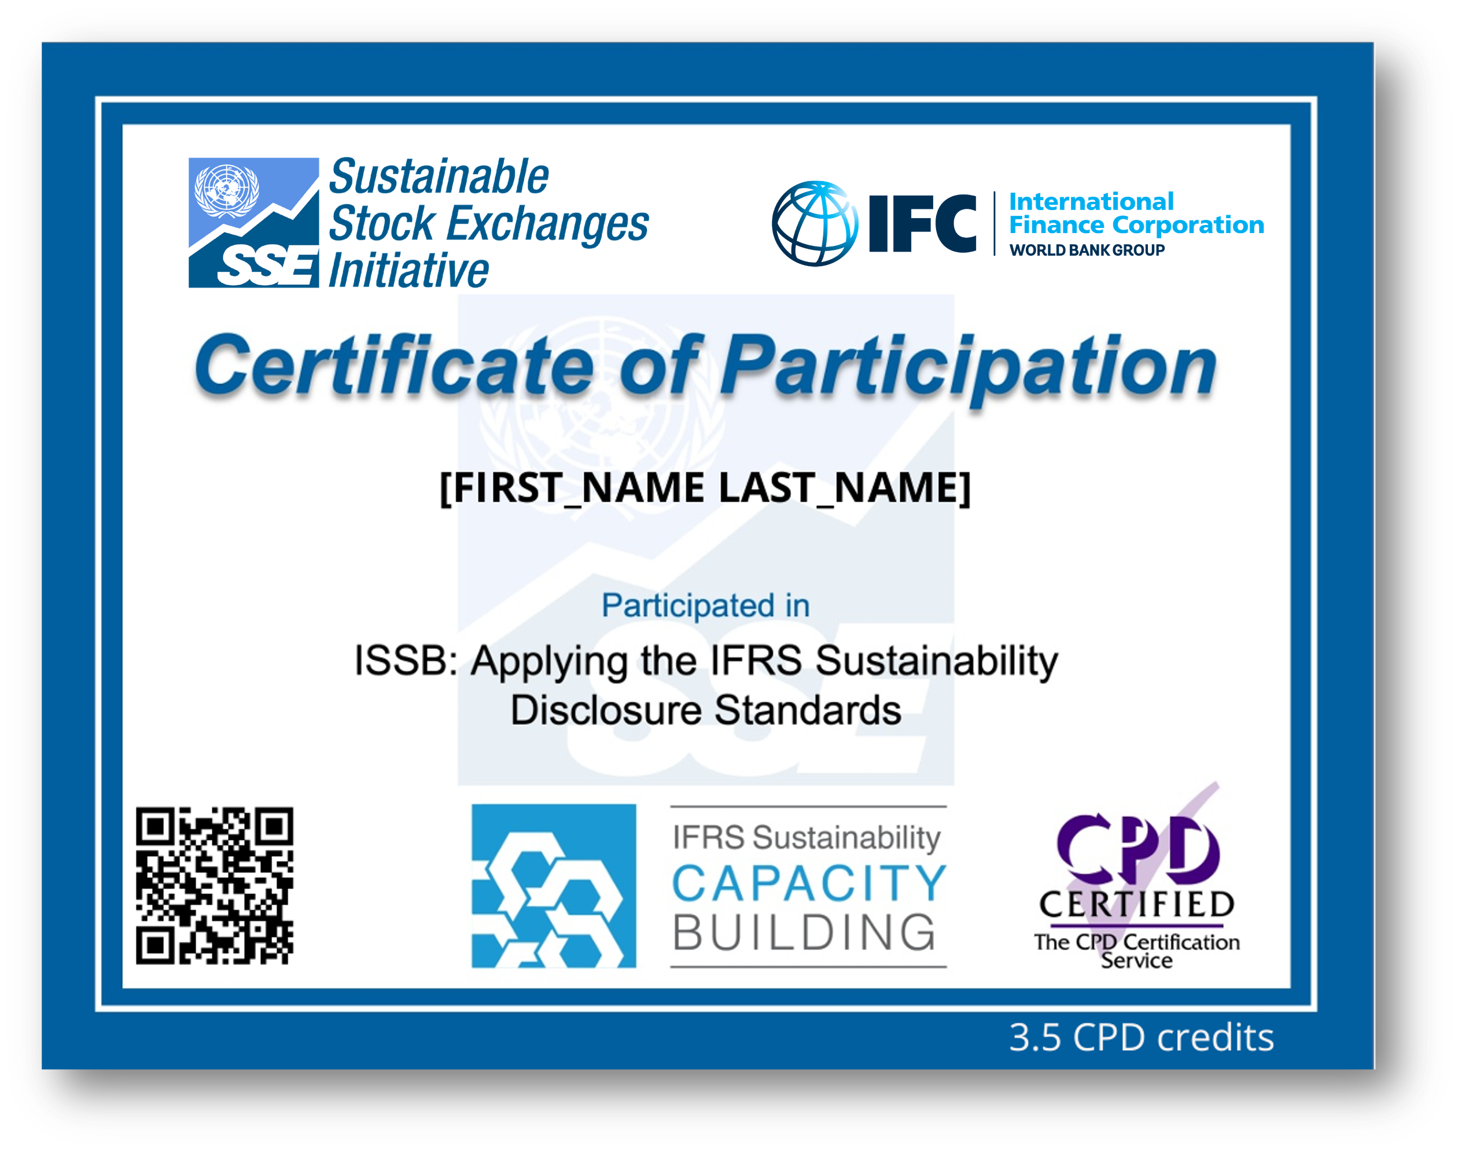
JOIN US ON DATE
TO RECEIVE YOUR
CPD CERTIFICATE
DATE

Slide 19
LOGOS – UN SSE
Note: You may chose to use whichever logo fits best your marketing materials. Only SSE Partner Exchanges can use the SSE Partner Exchange logo, and only SSE Official Supporters can use the Official Supporter logo
(note that official supporters provide the UN SSE with a voluntary financial contribution on an annual basis, so invoices must have been paid for the current year to use this logo)

Slide 20
LOGOS – Partners
Note: these logos may be used only for advertising for this training workshop on IFRS Sustainability Disclosure Standards
In partnership with IFC and the IFRS Foundation

Slide 21
How to tag UN SSE on your posts
Website: https://sseinitiative.org/
LinkedIn: United Nations Sustainable Stock Exchanges,
X (formerly Twitter): @SSEinitiative , https://twitter.com/SSEinitiative

