Slide 1
SSE Q2 Webinar
Climate Disclosure Training
10 June 2021: 9AM and 4PM CET (Geneva)
SSE Team
Anthony Miller
Lisa Remke
Rita Schmutz
Speakers
Fiona Quinlan (CDSB)
Ralitza Germanova (IFC)

Slide 2
Agenda
Housekeeping Issues & SSE Opening Remarks
TCFD & Climate Disclosure Training
Discussion, Q&A
SSE Updates and Closing Remarks
Please feel free to share ideas, feedback, updates and questions at any point during the call
(via chat function or via audio connection)
www.SSEinitiative.org | info@SSEinitiative.org | @SSEinitiative

Slide 3
Housekeeping
You can ask questions and provide comments at any time by using the chat function. We will ensure that questions get answered during the Open Floor discussion.
Please use the hand symbol to indicate that you wish to speak during the Open Floor discussion. The team will allow you to enable your video function while you speak.
If you are interested in providing free climate disclosure training to your market, email: climate@sseinitative.org
www.SSEinitiative.org | info@SSEinitiative.org | @SSEinitiative

Slide 4
New SSE Partner Exchanges
Now 103 SSE Partner Exchanges!
In May, the Bermuda Stock Exchange joined the UN SSE
In April, the UN SSE welcomed the Nicaragua Stock Exchange as an official member
www.SSEinitiative.org | info@SSEinitiative.org | @SSEinitiative

Slide 5
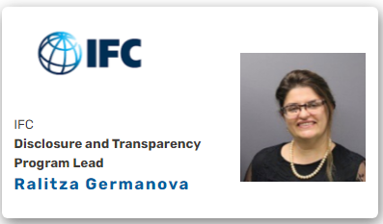
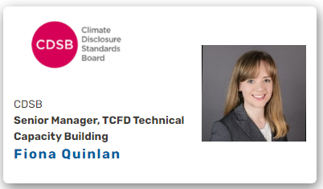
Climate Disclosure Training
Our training programme
Our training partners
SSE, IFC and CDSB joining forces to deliver training on climate disclosure
Programme is free of cost
Training for issuers, delivered in collaboration with exchanges
Focus on implementation of TCFD recommendations
If you are interested in providing free climate disclosure training to your market, email: climate@sseinitative.org
www.SSEinitiative.org | info@SSEinitiative.org | @SSEinitiative

Slide 6
Climate Disclosure Training
Frequently asked questions
What is the training program and for whom is it?
The training program can be offered by exchanges to their stakeholders and primarily addresses issuers and preparers of sustainability reports in companies.
Are there any costs related to the training?
No financial costs occur for the exchange or participants of the course. However, the exchange will assist in organizing outreach to its issuers and other relevant stakeholders.
How can exchanges partake?
Exchanges can reach out to: climate@sseinitative.org to receive more information and express their interest to offer the training to their market.
If you are interested in providing free climate disclosure training to your market, email: climate@sseinitative.org
www.SSEinitiative.org | info@SSEinitiative.org | @SSEinitiative
Notes:
Lisa/ Anthony & Ralitza

Slide 7
Climate Disclosure Training
Coming soon! Launch date 29 June.
The training is a continuation of the SSE work on the upcoming Model Guidance and Action Plan (to be launched on the 29 June).
The “two legs” of market education are guidance and training.
The climate disclosure training will complement the new SSE guidance documents and build on expertise from IFC and CDSB.
If you are interested in providing free climate disclosure training to your market, email: climate@sseinitative.org
www.SSEinitiative.org | info@SSEinitiative.org | @SSEinitiative
Notes:
Q2 Call notes:
1. STATUS: As many know - we've been working with our Climate advisory group on two foundational documents that we see as a key resource in training markets on climate disclosure and TCFD Specifically. We're pleased to announce that they will be launched later this month
REASON - Timely, fast moving - yet many exchanges still unsure how to address this topic
PROCESS - 100+ experts, 3 rounds
LAUNCH DETAILS - how to attend, how to access documents, etc.)
2. HOW TO USE: these two companion documents are resources for stock exchanges to assist in the integration and broader understanding of this topic market wide. The Action Plan provides exchanges with 5 key action areas where they can both lead through internal actions within the exchange and influence through market-oriented activities to ensure a holistic uptake. One key recommendation of the Action Plan is providing written guidance on climate-related financial disclosures, for which the Model Guidance on Climate Disclosure provides a template that exchanges can copy/paste and adapt to local market circumstances where needed.
ESG VS TCFD - Deepens the guidance provided in Model Guidance on ESG Disclosure, focusing a) on climate-related disclosures and b) on financial disclosures particularly.
3. LINK TO TRAINING: These documents are seen as a key resource for stock exchanges in any stage of their climate-related disclosure journey, so they should be seen as a foundation as well as an essential supplement resource throughout the training process. To ensure that exchanges can get the most from these guidance documents, however, we're also providing training to bring to life the topics found within the documents. Today we’re talking about training relating to the Model Guidance, and we'll discuss how your exchange can benefit from training for your issuers on this topic.

Slide 8
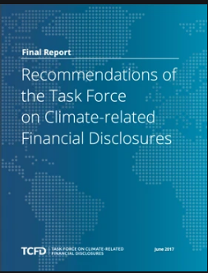
Climate Disclosure Training
Course Content Overview:
There are three course modules:
TCFD 101 provides an overview of what climate-related reporting is and why it is important. It will also provide participants with the global and regional context and focus on the initial steps on how to address the TCFD recommendations.
TCFD 102 provides an in-depth program during which participants will peer-review each others’ TCFD reports and wider good practice. For markets with no or very little reporting on TCFD, the course will focus on setting up internal processes for reporting and potential first areas to get started on.
TCFD 102E allows all participants of TCFD 102 to continue their dive into the climate disclosure universe through a self-taught e-learning experience.
If you are interested in providing free climate disclosure training to your market, email: climate@sseinitative.org
www.SSEinitiative.org | info@SSEinitiative.org | @SSEinitiative

Slide 9
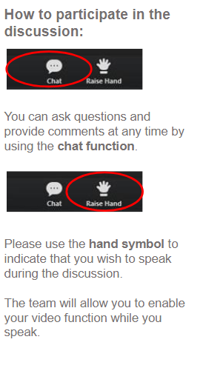
Open Floor Discussion
Please ask your questions using the chat function or raise your virtual hand!
If you are interested in providing free climate disclosure training to your market, email: climate@sseinitative.org
www.SSEinitiative.org | info@SSEinitiative.org | @SSEinitiative

Slide 10
SSE Secretariat Updates
New launch of a Gender Equality Advisory Group soon: Contact info@sseinitative.org for more information.
Online ESG guidance database: https://sseinitiative.org/esg-guidance-database/ - We are in the process of updating the database, so please do share with us any updated ESG documents and factsheets.
SSE Climate Disclosure Model guidance and Action Plan to be launched on the 29th June 2021, together with Mark Carnes, David Schwimmer and Leila Fourie!
Derivatives exchanges can soon become UN SSE partner exchanges! Contact the SSE team for more information!
www.SSEinitiative.org | info@SSEinitiative.org | @SSEinitiative

Slide 11
Thank you!
If you are interested in providing free climate disclosure training to your market, email: climate@sseinitative.org
www.SSEinitiative.org | info@SSEinitiative.org | @SSEinitiative

